Slide 1
Mathematics for Data Scientists — Esoph data set
KIESGEN de RICHTER Stanislas
VAIO Luca

Slide 2
Presentation of the data set

Slide 3
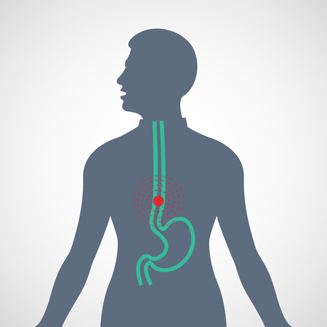
Origin of the data
Study of esophageal cancer in Ille-et-Vilaine, France.
Based on three criteria:
Age group
Tabaco consumption per day
Alcohol consumption per day

Slide 4
How is the data organised
Age group | Alcohol consumption (g/day) | Tobacco consumption (g/day) | Number of cases | Number of controls
25-34 | 0-39g/day | 0-9g/day | 0 | 40
35-44 | 0-39g/day | 10-19g/day | 1 | 14
45-54 | 80-119g/day | 30+ | 2 | 4
Number of combinations: 88
Number of persons controlled: 975

Slide 5
Controls distribution

Slide 6
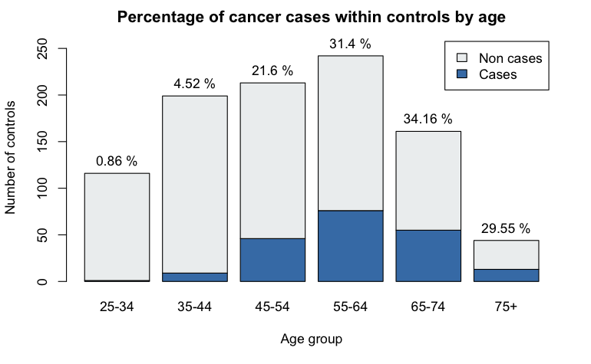
Cases per Age Group

Slide 7
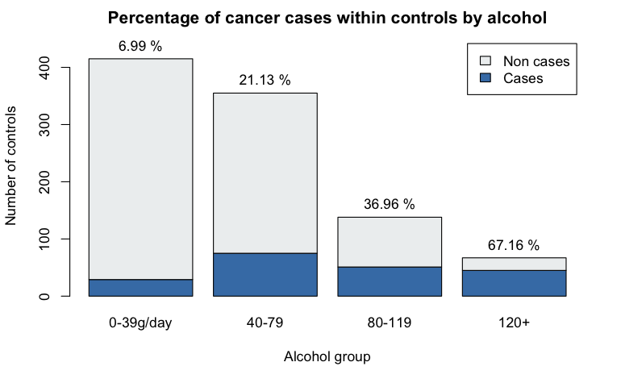
Cases per Alcohol Group

Slide 8
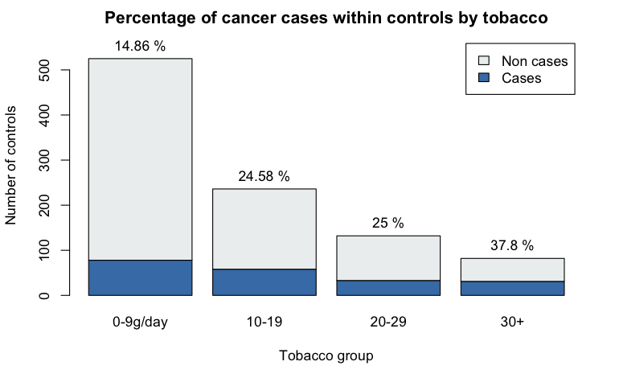
Cases per Tobacco Group

Slide 9
Hypothesis

Slide 10
Correlation hypothesis
→ independance χ² test

Slide 11
Age and cancers correlation
H₀: Age and cases are independent
H_{a}: Age and cases are correlated
p-value = 2.224e-13 << 0.05 threshold. H₀ is rejected.
Age and cancers are correlated
agegp | ncases | ncontrols
25-34 | 1 | 116
35-44 | 9 | 199
45-54 | 46 | 213
55-64 | 76 | 242
65-74 | 55 | 161
75+ | 13 | 44

Slide 12
Alcohol and cancers correlation
H₀: Alcohol and cases are independent
H_{a}: Alcohol and cases are correlated
p-value < 2.2e-16 << 0.05 threshold. H₀ is rejected.
Smoking and cancers are correlated
alcgp | ncases | ncontrols
0-39g/day | 29 | 415
40-79 | 75 | 355
80-119 | 51 | 138
120+ | 45 | 67

Slide 13
Smoking and cancers correlation
H₀: Tobacco and cases are independent
H_{a}: Tobacco and cases are correlated
p-value = 0.0003702 << 0.05 threshold. H₀ is rejected.
Smoking and cancers are correlated
tobgp | ncases | ncontrols
0-9g/day | 78 | 525
10-19g/day | 58 | 236
20-29g/day | 33 | 132
30+g/day | 31 | 82

Slide 14
Going further
A correlation is not sufficient to claim causality.
Thus, it would be interesting to look for links between alcoholism and smoking in cases of cancer.

Slide 15
Tobacco impact depending on alchohol

Slide 16
Model building

Slide 17
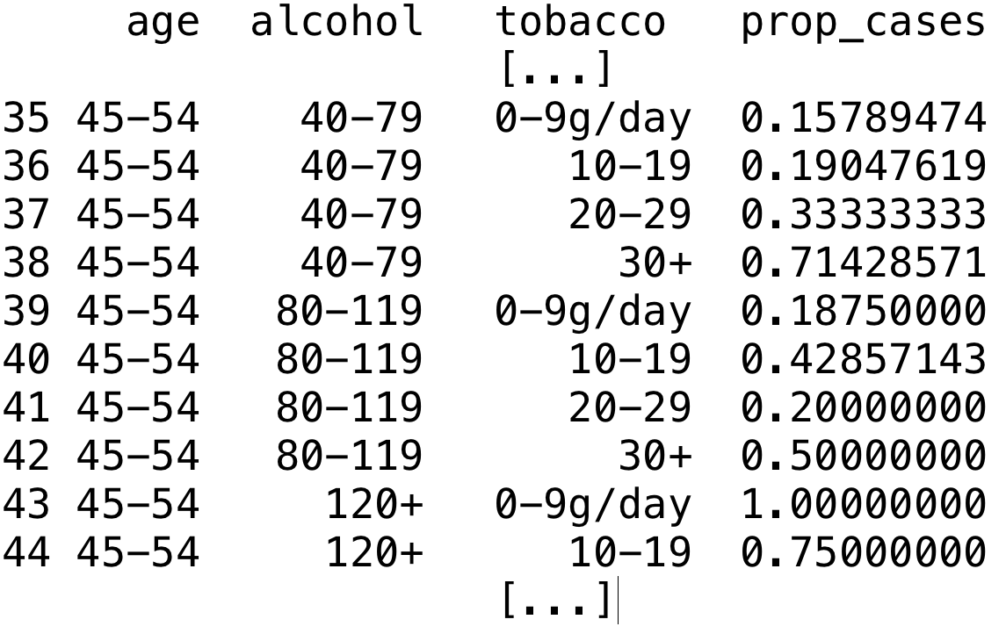
Building a proportions dataset

Slide 18
Age and cases proportions regression

Slide 19
Alcohol and cases proportions regression

Slide 20
Tobacco and cases proportions regression

Slide 21
What confirm our models
Tobacco is less correlated than age or alcohol with the increase in cancer cases, but that the value is very high from the outset.
A person who smokes little is almost as likely to develop cancer of the œsophagus as a person who smokes much more
Unlike age or alcohol, for which the probability increases gradually.

